Slide 1
Deaf Accommodation using head mounted displays

Slide 2
Acknowledgements:
National Science Foundation to study HMDs in planetariums for the project “EXP: Exploring augmented reality to improve learning by deaf children in planetariums” (IIS-1124548)
Sorensen Impact Foundation
Jean Massieu School of the Deaf, SLC

Slide 3
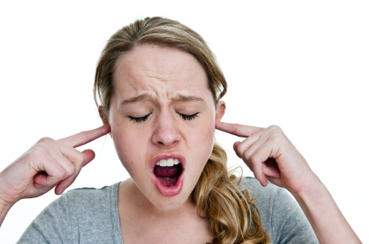
Pretend you are deaf
Notes:
As you watch this presentation try to pay attention to where you are looking.
You might be looking at me or at my slides.
To help you better understand how a deaf/hoh student experiences class,
when you aren’t looking directly at me,
put your hands over your ears and yell “I can’t hear you! I can’t hear you!” as loud as you can.
maybe it would be better if
I’ll simply stop talking whenever you aren’t looking directly at me.
I’ll continue the lecture in my head and when you look at me again I’ll start talking again.
You’ll miss the parts where you weren’t looking at me.
That’s the problem that deaf/hoh students face in class.

Slide 4
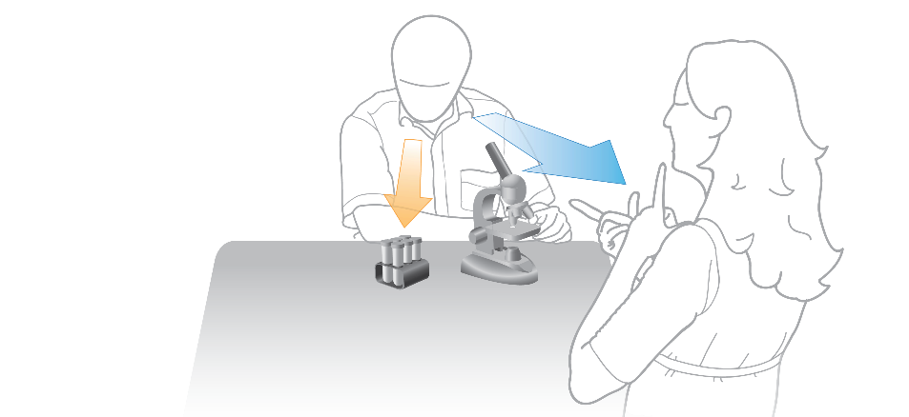
Defining the problem
Playing “telephone” with the information
Humans can only watch one thing at a time
Teachers often “show” and “explain” at the same time.
Interpreters are off to the side.
Lab settings compound the problem
Notes:
Accessing information is a challenge for Deaf students.
Deaf students commonly complain of “tennis neck” because they have to move their head so much to try to see all of the information.
Not only is it physically taxing, it is impossible to catch everything.
Interpreters who have no expertise in science and are deciding how to phrase your explanations.
Earth orbits “moon” rather than “sun”

Slide 5
Best practices
Pay attention to line-of-site
Avoid talking during critical phases of demonstrations
Limit talking while students are reading slides
Always talk to the student, not the interpreter.
Always face the students when speaking.
Notes:
Try to be aware of where you are relative to the interpreter and written material.
If the student needs to watch what you’re doing, don’t talk at the same time.

Slide 6
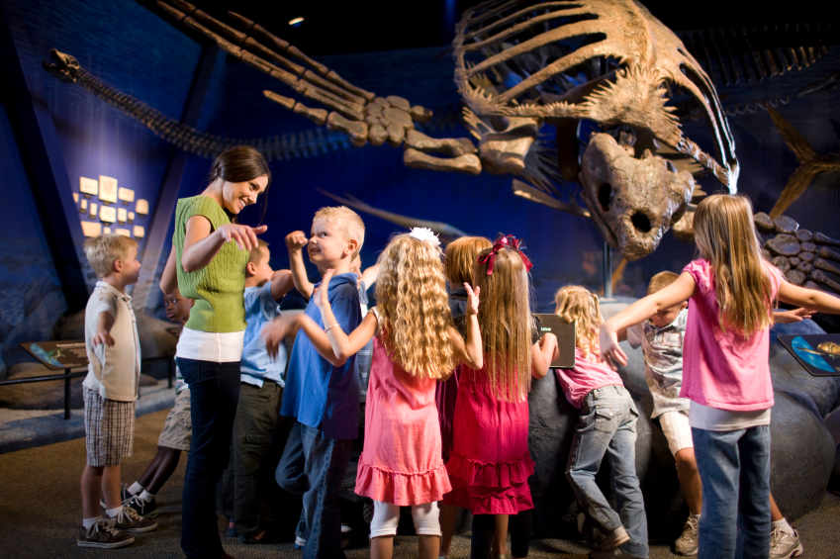
Why are deaf people under-represented?
Students Who Demonstrate Strong Talent and Interest in STEM Are Initially Attracted to STEM through Extracurricular Experiences 2014 A. VanMeter-Adams et al. CBE—Life Sciences Education
Notes:
This is a picture of a class on a field trip.

Slide 7
Typical “mainstreamed” class
Notes:
Let’s pretend that these two students are deaf.
So they bring along an ASL interpreter. But there’s a problem.
Where do we put the interpreter and how do the students keep up?

Slide 8
Notes:
If the interpreter is over here, students can either watch the interpreter or look at the big turtle dinosaur thing.
Since there’s so much to look at, it’s impossible to put the interpreter in the right spot.

Slide 9

Notes:
In this project, students will design, implement and evaluate a head mounted display system that allows deaf/hoh students to see their interpreter wherever they look.
There’s many open questions about the best way to use head mounted displays to accommodate deaf/hoh students.
This project gets at the first questions:
how do we build the system?
how do we configure the system?
The purpose of this capstone is to design and build a prototype. Time permitting, we’ll run some laboratory trials with deaf/hoh students to figure out how to configure the system.
The next questions are:
does the system improve learning?
and then there’s some questions about cognition that we can answer.

Slide 10
http://youtu.be/EeSiZfPzfoI

Slide 11
Where does astronomy and a planetarium come in?
The planetarium isn’t a planetarium, it’s a simulator. The planetarium provides a controlled 3d space where every group will have nearly identical experiences. You don’t have the same control on other field trips.
You need to test with some content, it might as well be science. The science content is good test material because students, deaf and hearing, have limited a priori experience.

Slide 12
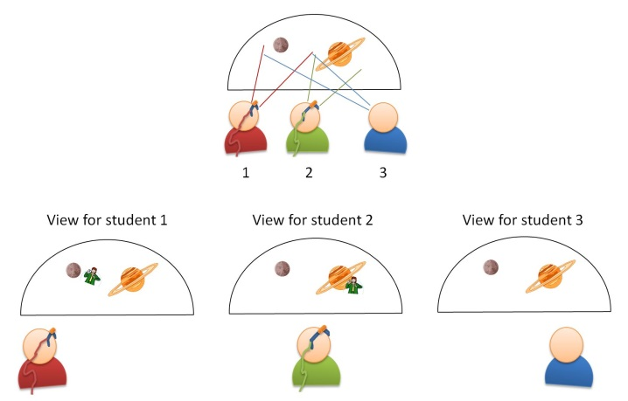

Slide 13
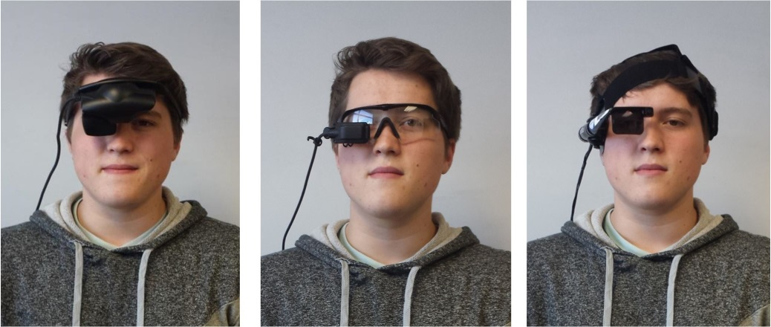
Phase 1: What Type of HMD?

Slide 14
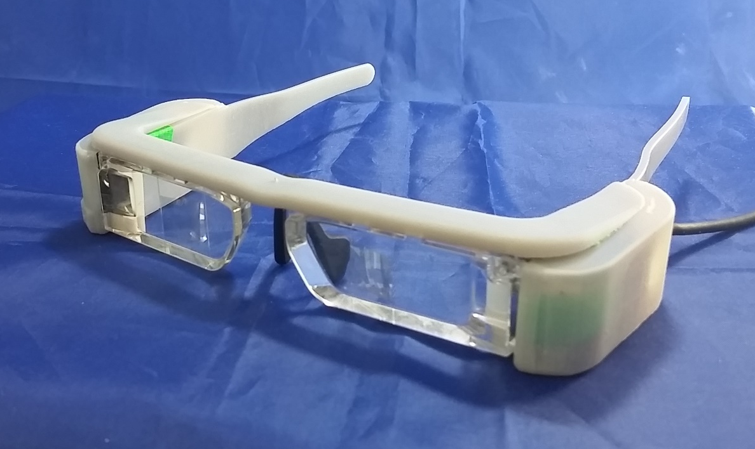
The winner
AR
binocular
transparent image
projected center.

Slide 15
Test Learning
Watch a filmed show, interview students about content. Code for specific use of “classifiers” introduced by the narrator.
  Control watched the ASL projected directly onto the front of the dome.
  HMD group watched pre-recorded track through HMD
Watch a live constellation show, quiz students on 18 constellations
  ½ of the students watched an interpreter in front of them.
  ½ of the students watched the interpreter through the HMD.
  After 9 constellations, the students swapped.

Slide 16
Results
In shows using HMDs
  Students adopted as many unique classifiers as students watching an interpreter projected on the dome.
  Students learning constellations were able to identify at least as many constellations (14/18 correct) as students taught using a “traditional” interpreter (8/18 correct).
Notes:
Note, because of small sample size significance is hard to obtain. But we can conclude that it meets the “do no harm” criteria.

Slide 17
Conclusions
HMDs show promise for mitigating the split attention issues.
The deaf community likes the idea.

